Slide 1
League of Legends Predictor
Luis Ruiz

Slide 2
Problem Identification
TSM League of Legends team needs to prepare for the upcoming season, we want to determine what aspects of the game and what roles to focus on in order to maximize our chances of wining. Our goal is to increase our win rate by at least 1%.

Slide 3
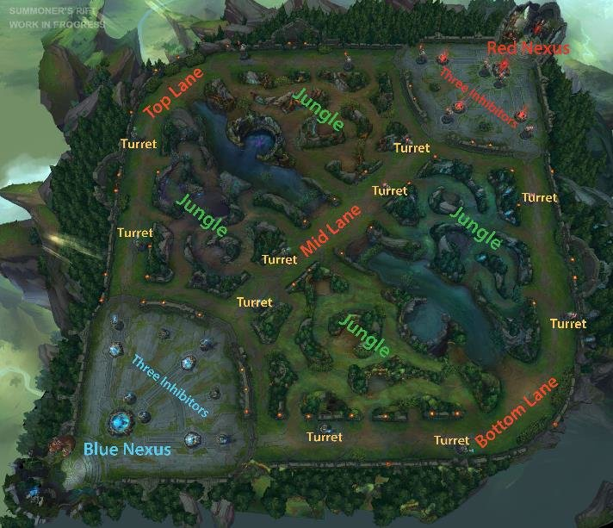
Context
League of Legends consist of 2 teams. Blue team and Red team.
There are 5 roles in the game which are:
Top
Mid
Jungle
ADC
Support

Slide 4
Context cont.
In game features:
Dragons
Barons
Jungle minions
Minions
Towers
Wards
Herald

Slide 5
Data Overview
Dataset includes data from high-ranking Diamond 1 to Masters competitive matches
Approximately 10,000 observations
40 columns
0 missing data
Data includes in games observations of the first 10minutes of a match
Target variable is whether the match resulted in a win or loss

Slide 6
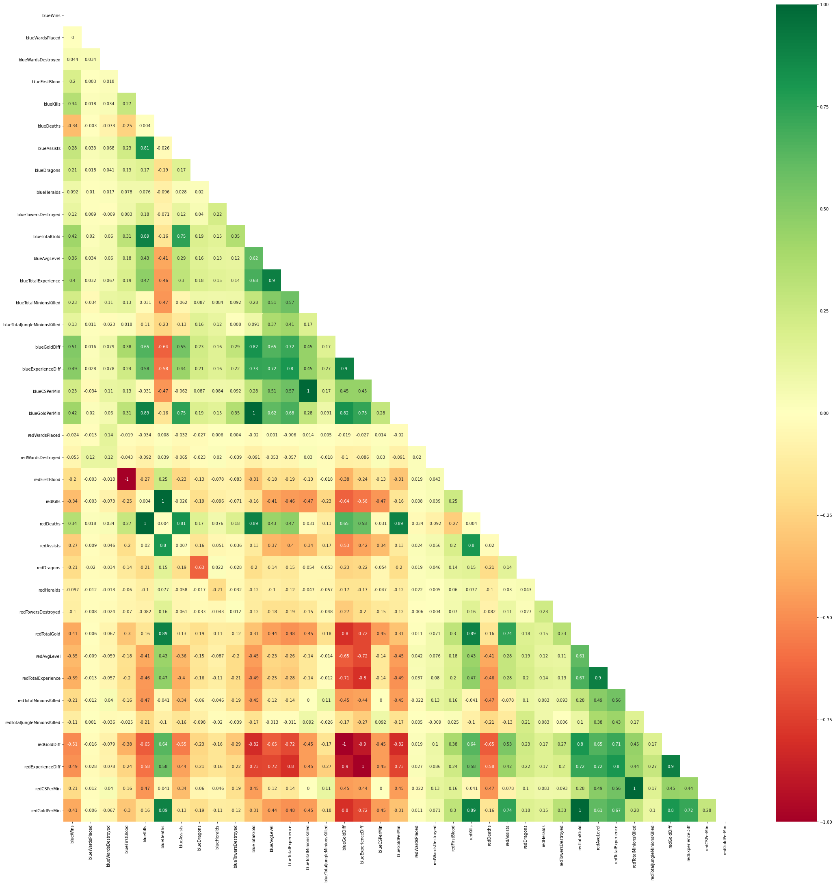
Exploratory Data Analysis
Our initial Data set contains a lot of level of positive and negative levels of multicollinearity
Using Lasso and my domain knowledge we dropped about half of our columns

Slide 7
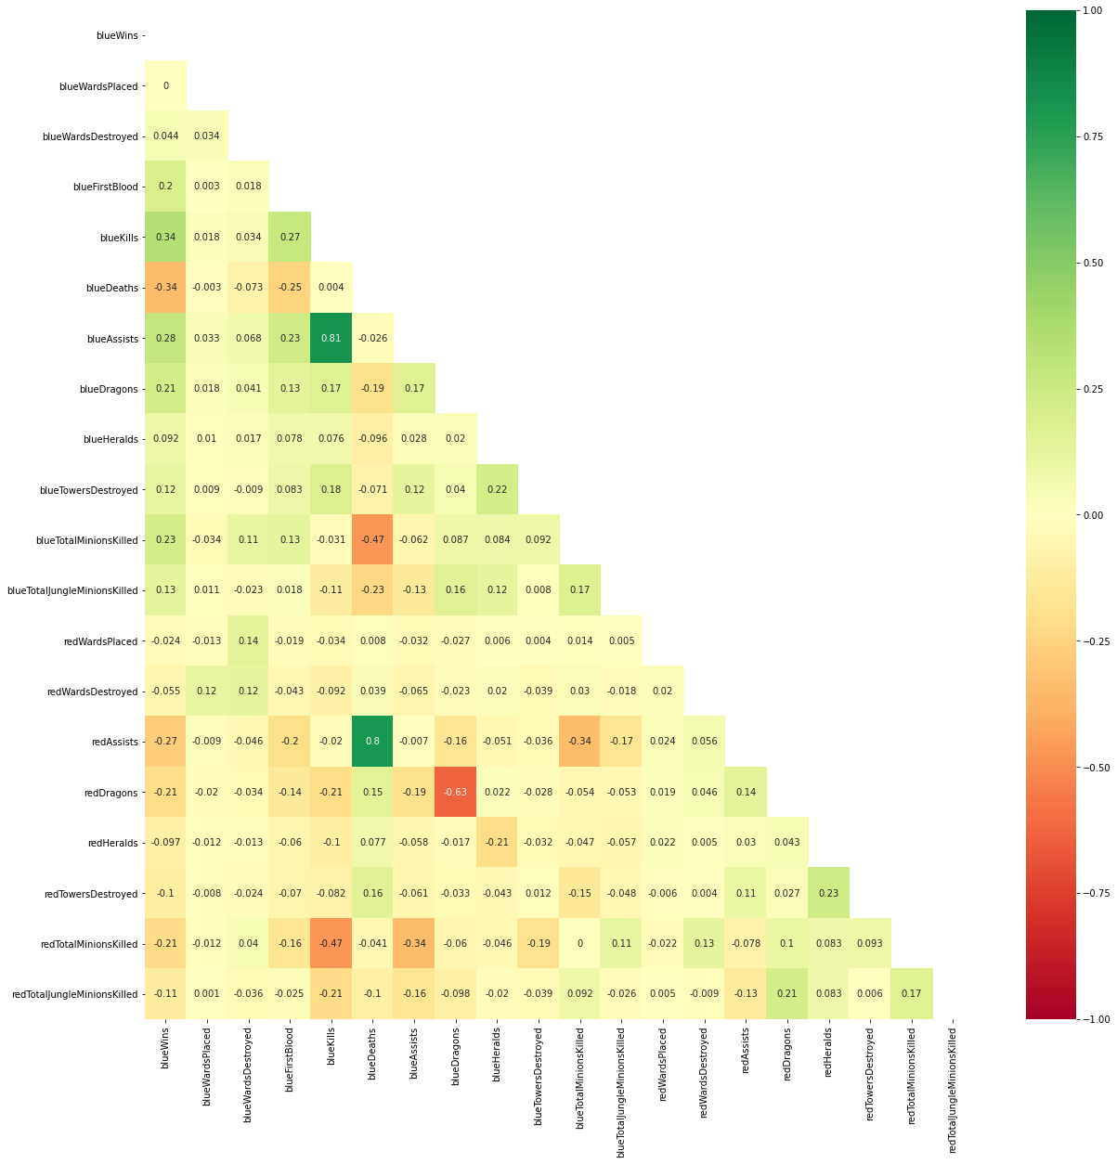
Exploratory Analysis cont
Remaining columns are 20
Lower level of multicollinearity
Our Logistic models will not suffer from distinguishing the true weights of each feature

Slide 8
Feature Engineering
Train Test Split our model to 80% and 20%
Train our model using 80% of our data and used the 20% to test how accurate it was.
Standardized our dataset to keep our data consistent
Each column has the same content and format
Cross validation

Slide 9
Modeling
Some of the models used were
Basic Logistic Regression with CV
Logistic Regression with GridSearchCV
Logistic Regression with RandomSearchCV
Random Forest
XGBRF
XGBRF with GridSearchCV

Slide 10
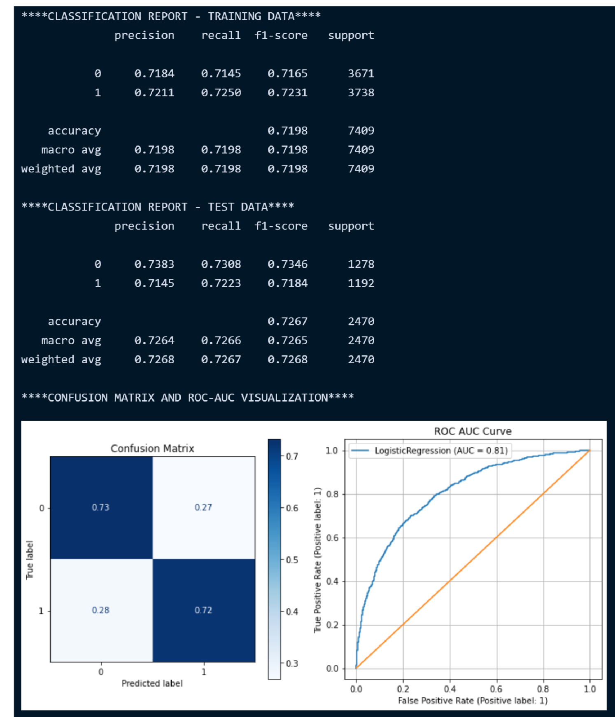
Best Performing Model
Best performing model was Basic Logistic Regression
Our model accurately predicted about 73% of the game outcome
Our AUC is about 81% at separating TP vs FP
No signs of Overfitting
Quick and not very resource hungry

Slide 11
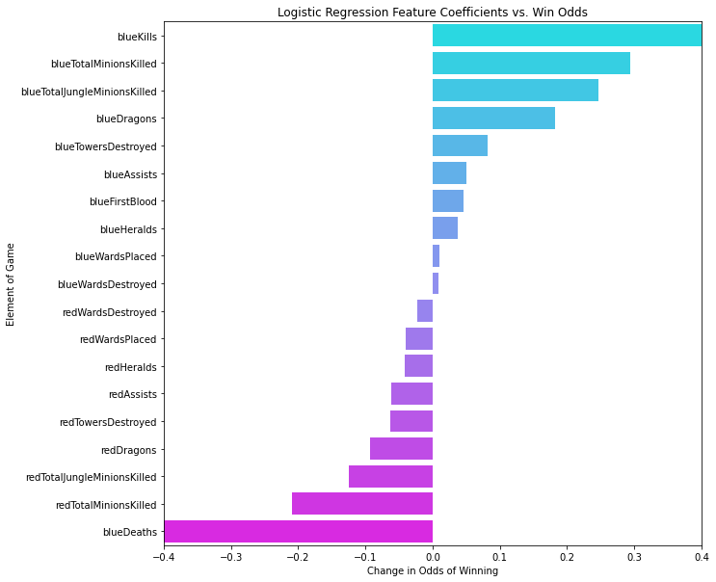
Feature Importance
Top 5 highest coefficient vs Win Odds
blueKills
blueTotalMinionsKilled
blueTotaljungleMinionsKilled
blueDragons
bluetowersdestroyed

Slide 12
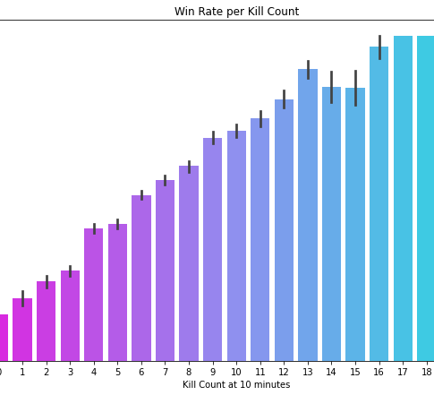
BlueKills
Recommend to shoot for at least 7 kills to increase our win percentage by at least 1%

Slide 13
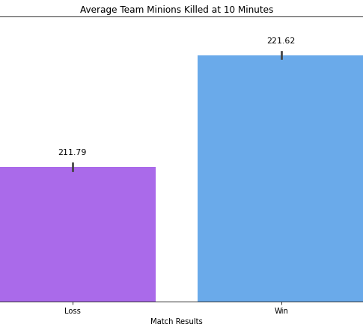
Minions Farmed
Recommend to aim farm at least 222 minions as a team

Slide 14
Conclusions & Recommendations
Conclusion
Based on the above findings, we can see that gold, experience, and dragons kills the highest impact on the outcome of a LoL game
Recommendations
Focus heavily on gaining gold by having all laners last hit minons this can be done by using in game sanbox
Absorving as much EX as possible by staying in lane and avoiding getting ganked or killed
Warding our jungle 30 seconds before it spawns

Slide 15
QUESTIONS?

